Slide 1
Research Methodology
Superstore Sales Dashboard and Forecasting
In this report I use Exploratory Research Method.
The Data set we use in this project is collected from secondary source.
The tool here is use to analyze the data is Microsoft PowerBI.
DESCRIPTION
Dashboard Creation: Identify the KPI, add interactive visualization and filtering capability to allow users to explore the data at various level of granularity.
Data Analysis: Provide valuable insights to business entities regarding the effectiveness of their sales strategies through visualization and charts.
Sales Forecasting: Leverage historic data and apply time series analysis to generate sales forecasting for next 15 days.

Slide 3
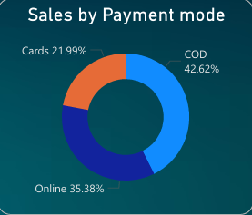
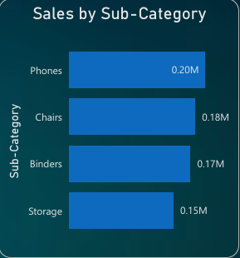
Sales by Payment Mode
This is called as Donut Chart. In which we have differentiate the payment mode.
Where you can see the most used payment mode by the consumer.
If the consumer is using any card, and we having card details, then we can give offers to the consumer based on their card.
Sales by Sub-Category
This is called as Clustered Bar Chart.
In this segment we can see the sales by sub categories like Phones, Chairs, Binders, Storage etc.
Which category is the most selling category in the superstore.
By this we can increase and decrease the supply of the assets.

Slide 4
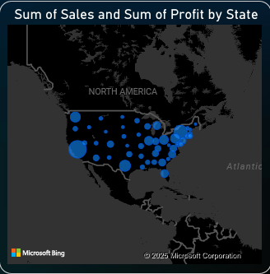
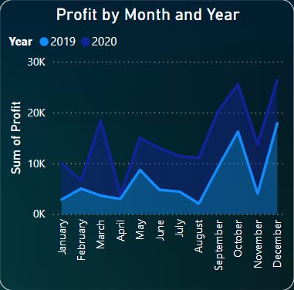
Sales and Profit by State
This is a Map visual.
In which we can see the sum of profit and sum of sales in the states.
The different Bubble size shows the most and least sales between the states.
Profit by Month and Year
This is called Stacked Area Chart.
In this we have compared two years of data(2019,2020), that shows the Profit per month between two years.
By this we can see in which month of the year have most Profit.

Slide 5
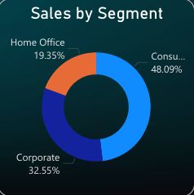
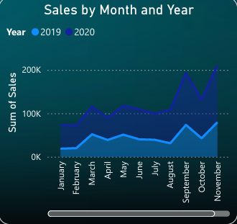
Sales by Segment
This is called as Donut Chart. In which we have differentiate the sales by Segment.
There are three segment in the data, home office, consumer and corporate.
The most sales are in the consumer segment compare to others.
We can use different colors to differentiate the segment.
Sales by Month and Year
This is called Stacked Area Chart.
In this we have compared two years of data(2019,2020), that shows the Sales per month between two years.
By this we can see in which month of the year have most Sales.

Slide 6
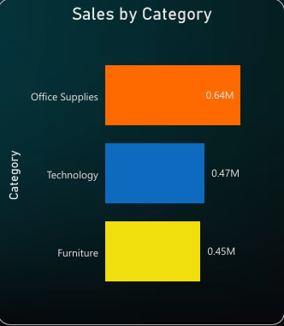
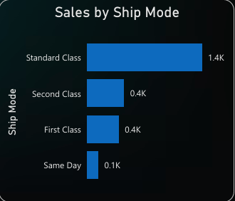
Sales by Category
This is called as Clustered Bar Chart.
In this Clustered Bar Chart we can see the sales by the categories.
Which category has the most demand in the store.
By this we can give the consumer the goods they need.
Sales by Ship Mode
This is also a Clustered Bar Chart. In this we can see the Ship Mode prefer by the consumers.
The consumer prefer the Standard Ship mode the most.
In this chart we compare the sales by ship mode.

Slide 7





KPI - Key Performance Indicator
KPIs are measurable values that help assess how effectively an organization is achieving its business objectives.
Actual Value: The current value representing actual performance.
Status Indicator: A visual indication (e.g., red, yellow, green) showing if the target is met or exceeded.
Target Value: The goal or benchmark you want to measure against.
Slicer
A Slicer in Power BI is a visual filter that allows users to filter data dynamically on a report or dashboard.
Types of Slicers:
List: Displays options as a list, and users can select one or multiple values.
Dropdown: Displays options in a dropdown menu, saving space on the report.

Slide 8
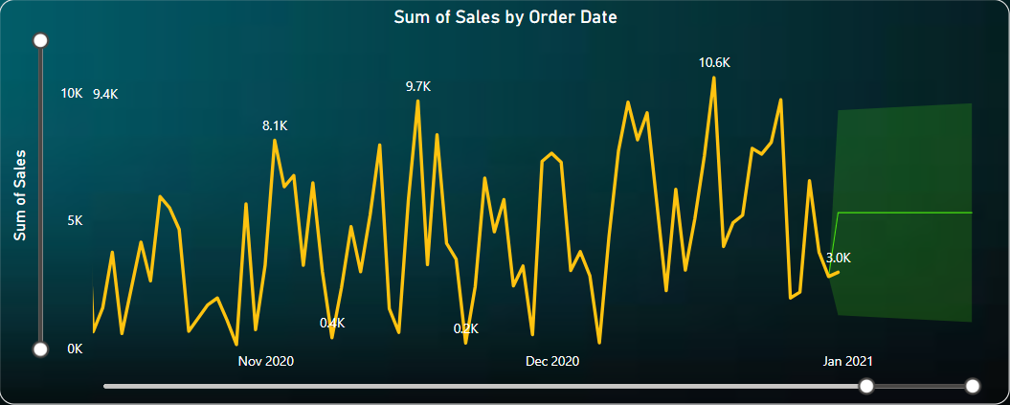
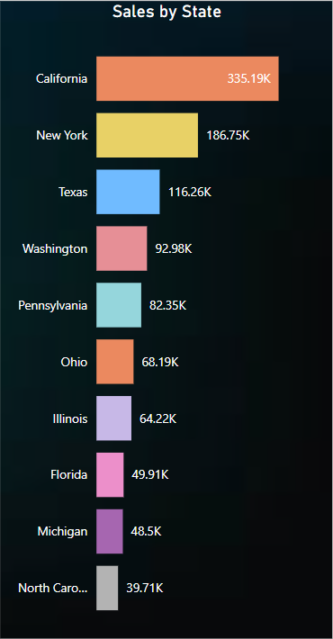
SALES FORECASTING
For Sales Forecasting we use Line Chart in PowerBI.
We have Forecast the data for 15 days.
Confidence Interval in data is 95%
Confidence Interval is how much confidence you have on your data for the forecasting.
By this line chart we can see what will be the sales for next 15 days using the forecasting method in PowerBI.
Sales by State
Sales by State, which state have more number of sales compare to other states.

